Slide 1

Hostel Management System
A Full-Stack Web Application for Streamlined Hostel Operations
Santosh | Roll No: 23suca18

Slide 2
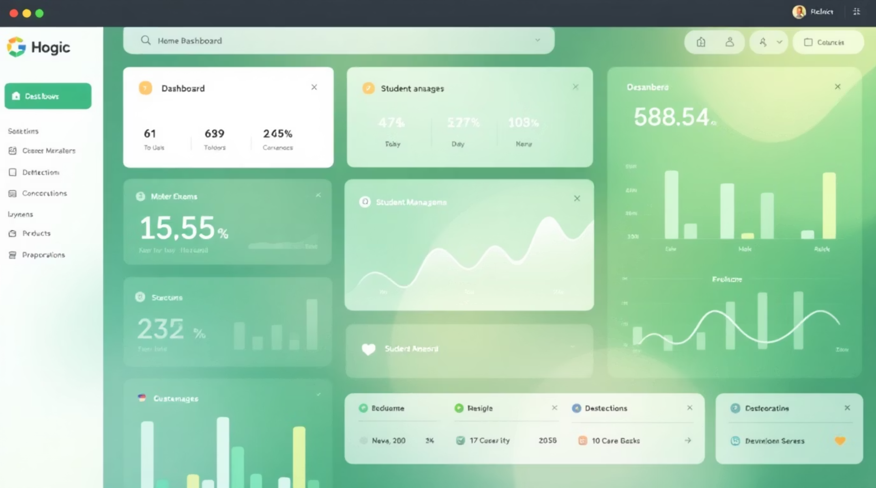
PROJECT OVERVIEW
Transforming Hostel Administration
The Hostel Management System is a comprehensive web application designed to modernize and streamline hostel operations. This full-stack solution provides efficient tools for managing students, room allocations, and administrative tasks.
Core Capabilities
Student registration and profile management
Real-time hostel and room allocation tracking
Comprehensive allocation history and reporting
Dedicated admin dashboard with analytics

Slide 3

System Architecture & Technology Stack
Frontend (React)
Deployed on Vercel
Docker Containerization
REST APIs
Full‑Stack Architecture
HTTP interface between layers
Containerizes services
Backend (Spring Boot)
H2 Database
In-memory/dev data store
Hosted on Render platform

Slide 4

FEATURES
Key Functionalities & Live System
RESTful API Backend
Student Portal
Admin Dashboard
Comprehensive endpoints including /api/students, /api/hostels, and /api/rooms for complete CRUD operations with JSON responses
Intuitive interface for students to view room assignments, check availability, and submit allocation requests with real-time updates
Powerful management console for administrators and hostel managers to handle allocations, monitor occupancy, and generate reports
Live Frontend
Live Backend API
hostel-management-frontend-beta.vercel.app
hostel-management-backend-rc9d.onrender.com

Slide 5

Challenges Encountered
Developing and deploying a full-stack application presented several significant technical hurdles that required creative problem-solving and persistence.

Slide 6
TECHNICAL OBSTACLES
Development & Deployment Challenges
Cross-Origin Resource Sharing (CORS)
Render Free Tier Limitations
CI/CD Pipeline Configuration
Backend experienced cold start delays and automatic idle shutdowns after 15 minutes of inactivity, impacting user experience and API response times
Setting up GitHub Actions workflow for automated SonarCloud code quality analysis required careful YAML configuration and authentication token management
Frontend hosted on Vercel couldn't communicate with backend on Render due to strict browser security policies blocking cross-origin requests
Git Repository Bloat
Vercel Build Permissions
Accidentally committed large compiled JAR files and Docker images to version control, causing repository size issues and slow clone operations
Encountered permission errors during deployment with react-scripts build command, preventing successful frontend compilation on Vercel platform

Slide 7
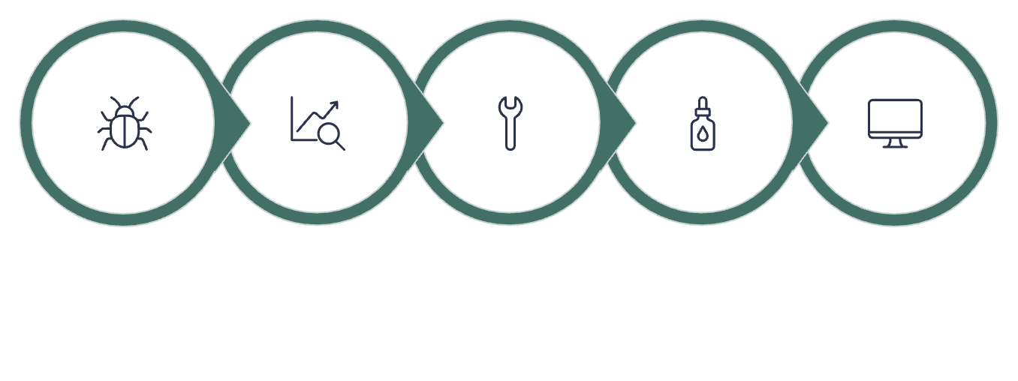
Solutions & Technical Fixes
1
CORS Configuration
Implemented Spring Boot CORS mappings to whitelist Vercel frontend domain, enabling secure cross-origin API requests
2
Docker Containerization
Created optimized Dockerfile for consistent backend deployment and faster cold start recovery on Render platform
3
Automated Quality Checks
Configured GitHub Actions with SonarCloud integration for continuous code quality monitoring on every commit
Identify Issue
Research Solution
Implement Fix
Test Deployment
Monitor Performance
4
Repository Cleanup
Updated .gitignore to exclude target directory and large binaries, cleaned Git history to reduce repository size
5
Frontend Build Fix
Cleared node_modules, updated dependencies, and reconfigured Vercel build settings to resolve permission issues

Slide 8
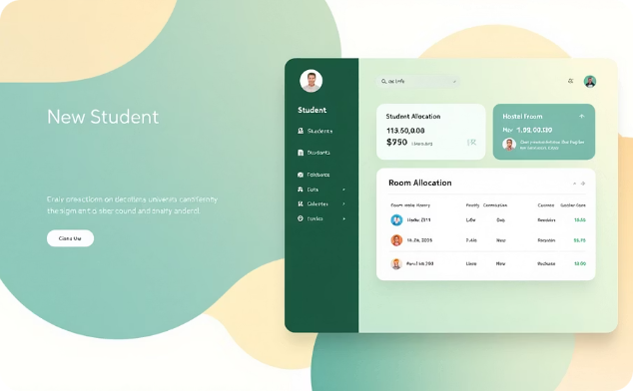
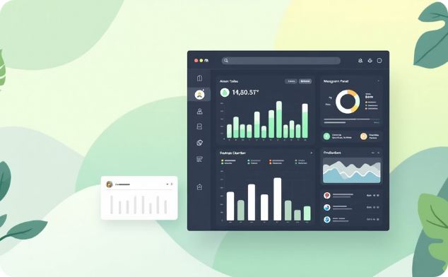
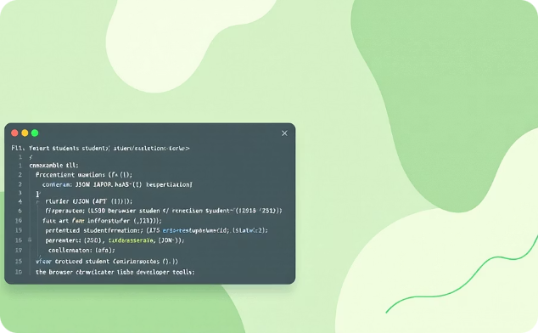
DEMO
System Screenshots & API Responses
Student Portal Interface
Admin Management Console
Backend API Response
Clean, intuitive dashboard for viewing assignments and requesting room changes
Comprehensive tools for managing students, rooms, and generating reports
RESTful endpoints returning structured JSON data for seamless frontend integration

Slide 9

Key Learnings & Technical Growth
This solo project provided invaluable hands-on experience across the entire software development lifecycle, from design through deployment and maintenance.
1
Backend Development
Mastered Spring Boot REST API design, dependency injection, and JPA for database operations
2
Frontend Engineering
Built responsive React components with state management and asynchronous API integration using Axios
3
DevOps & Deployment
Gained practical experience with Docker containerization, cloud platforms, and CI/CD automation
4
Code Quality
Implemented automated testing and continuous code analysis with SonarCloud integration

Slide 10
Project Resources & References
Access the Code
Backend Repository
Frontend Repository
All source code is publicly available on GitHub with comprehensive documentation and setup instructions.
github.com/sandy13226/hostel-management-backend
github.com/sandy13226/hostel-management-frontend
Spring Boot backend with REST APIs, Docker configuration, and database schema
React application with component architecture and responsive UI design
hank you for your time and consideration. Questions welcome.

